Slide 1

How’s your revision going?
Here are a couple of things to keep you on track!

Slide 2

"You don't have to be good to start...
You just have to
start to be good."
Joe Sabah

Slide 3

Many of us don't get going because we fear we're not good enough.
But the only way to get good is to begin.

Slide 4

Commit to a specific time and start revising tonight!

Slide 5

"Start from wherever you are
and with whatever you've got."
Jim Rohn

Slide 6

We can waste so much time wishing we were smarter.
When all we need to do is focus on improving.

Slide 7
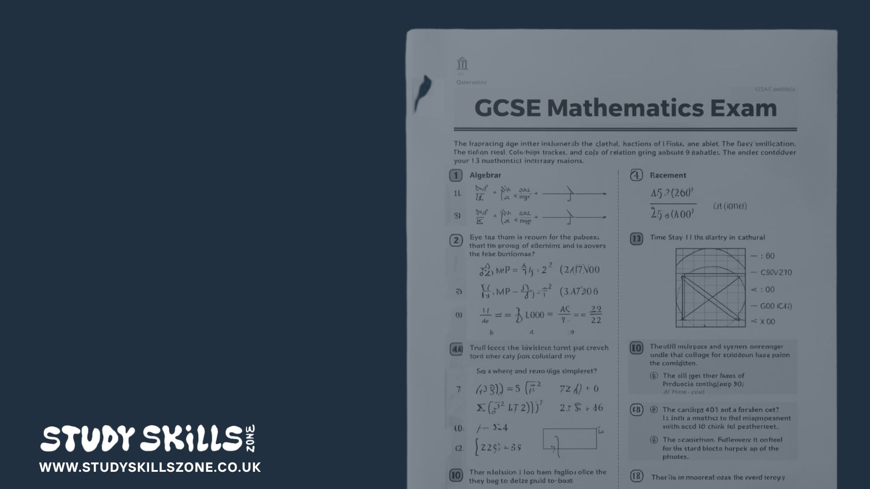
Pick one weak topic from one subject and revise it today!

Slide 8

"Practice creates confidence.
Confidence empowers you."
Simone Biles

Slide 9

You may not believe you're capable of good grades today
but if you start revising,
you'll start improving
and then you'll start believing in yourself!

Slide 10

Work on that weak topic every day for one week and you'll grow in confidence. You can do it!

Slide 11


