Slide 1

Y13 Countdown

Slide 2

"If you need confidence,
talk to yourself
the way you would
talk to a friend."
James Clear
author of ‘Atomic Habits’

Slide 3

Y13 is HARD
It's easy to lose confidence
if you talk to yourself negatively.

Slide 4

Action:
Write down what you'd say to a friend if they told you that they were struggling with their studies.
Pin it where you work to encourage yourself.

Slide 5

"Progress,
not perfection,
is what we should be asking of ourselves."
Julia Cameron

Slide 6

Your ideal grades may feel out of your reach at this moment.
However, the key to reaching them is showing up every day to work on your weaknesses.
Then your grades will look after themselves.

Slide 7

Action:
Pick one weak topic tonight and put your energy there.

Slide 8

While the nights are still long, dark and cold,
why not boost your revision hours?
Imagine a future version of yourself
picking up your envelope on results day
and use it as motivation to stay on track.

Slide 9
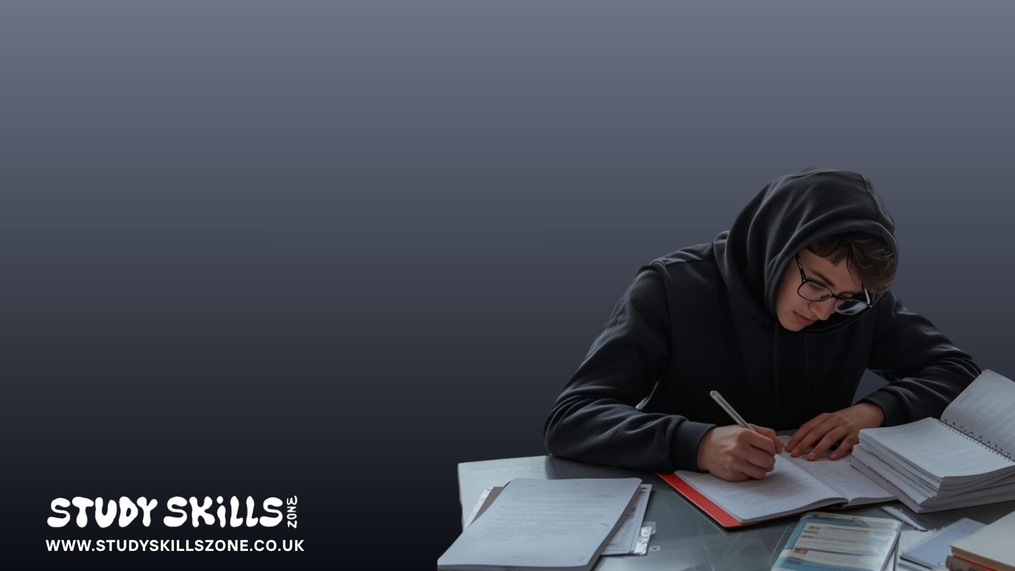
"Work hard in the winter,
show off in the summer."
Anon

Slide 10

Action:
Commit to a set amount of revision for one week. Then match it the following week.
And the next etc.

Slide 11

And finally, for any students that are struggling to get going at all, here's another great passage from author, James Clear…

Slide 12

"Two is twice as good as one, but one is infinitely better than zero.
One minute of making sales calls is infinitely better than zero minutes.
One minute of meditation is infinitely better than zero minutes.
One minute of writing is infinitely better than zero minutes.
Sure, it might be ideal to spend an hour doing these things, but one minute gets you in the game.”
James Clear

Slide 13
“Now you're learning. Now you're improving. Now results are possible. One doesn't seem like much, but it's something real. At zero, you're still dreaming."
James Clear

Slide 14


Slide 15
If you don't have a revision routine,
it can feel hard to get started but today is the day!
Action: Even if it's only 15 minutes - get going tonight!
You can increase your revision hours another time.
Just begin!

Slide 16



Explore practical, research-based study skills workshops designed for sixth form students at www.studyskillszone.co.uk.

