Slide 1


studyskillszone.co.uk
During half-term
DO NOT REVISE

Slide 2
studyskillszone.co.uk
During half-term
DO NOT REVISE
THE TOPICS YOU ALREADY KNOW!

Slide 3
studyskillszone.co.uk
FLIP THE THINKING

Slide 4

studyskillszone.co.uk
HALF TERM IS A CHANCE TO
TAKE CONTROL OF YOUR FUTURE.

Slide 5


studyskillszone.co.uk
IDENTIFY THE WEAK TOPICS
THEN SET TO WORK
FUTURE TENSE

Slide 6

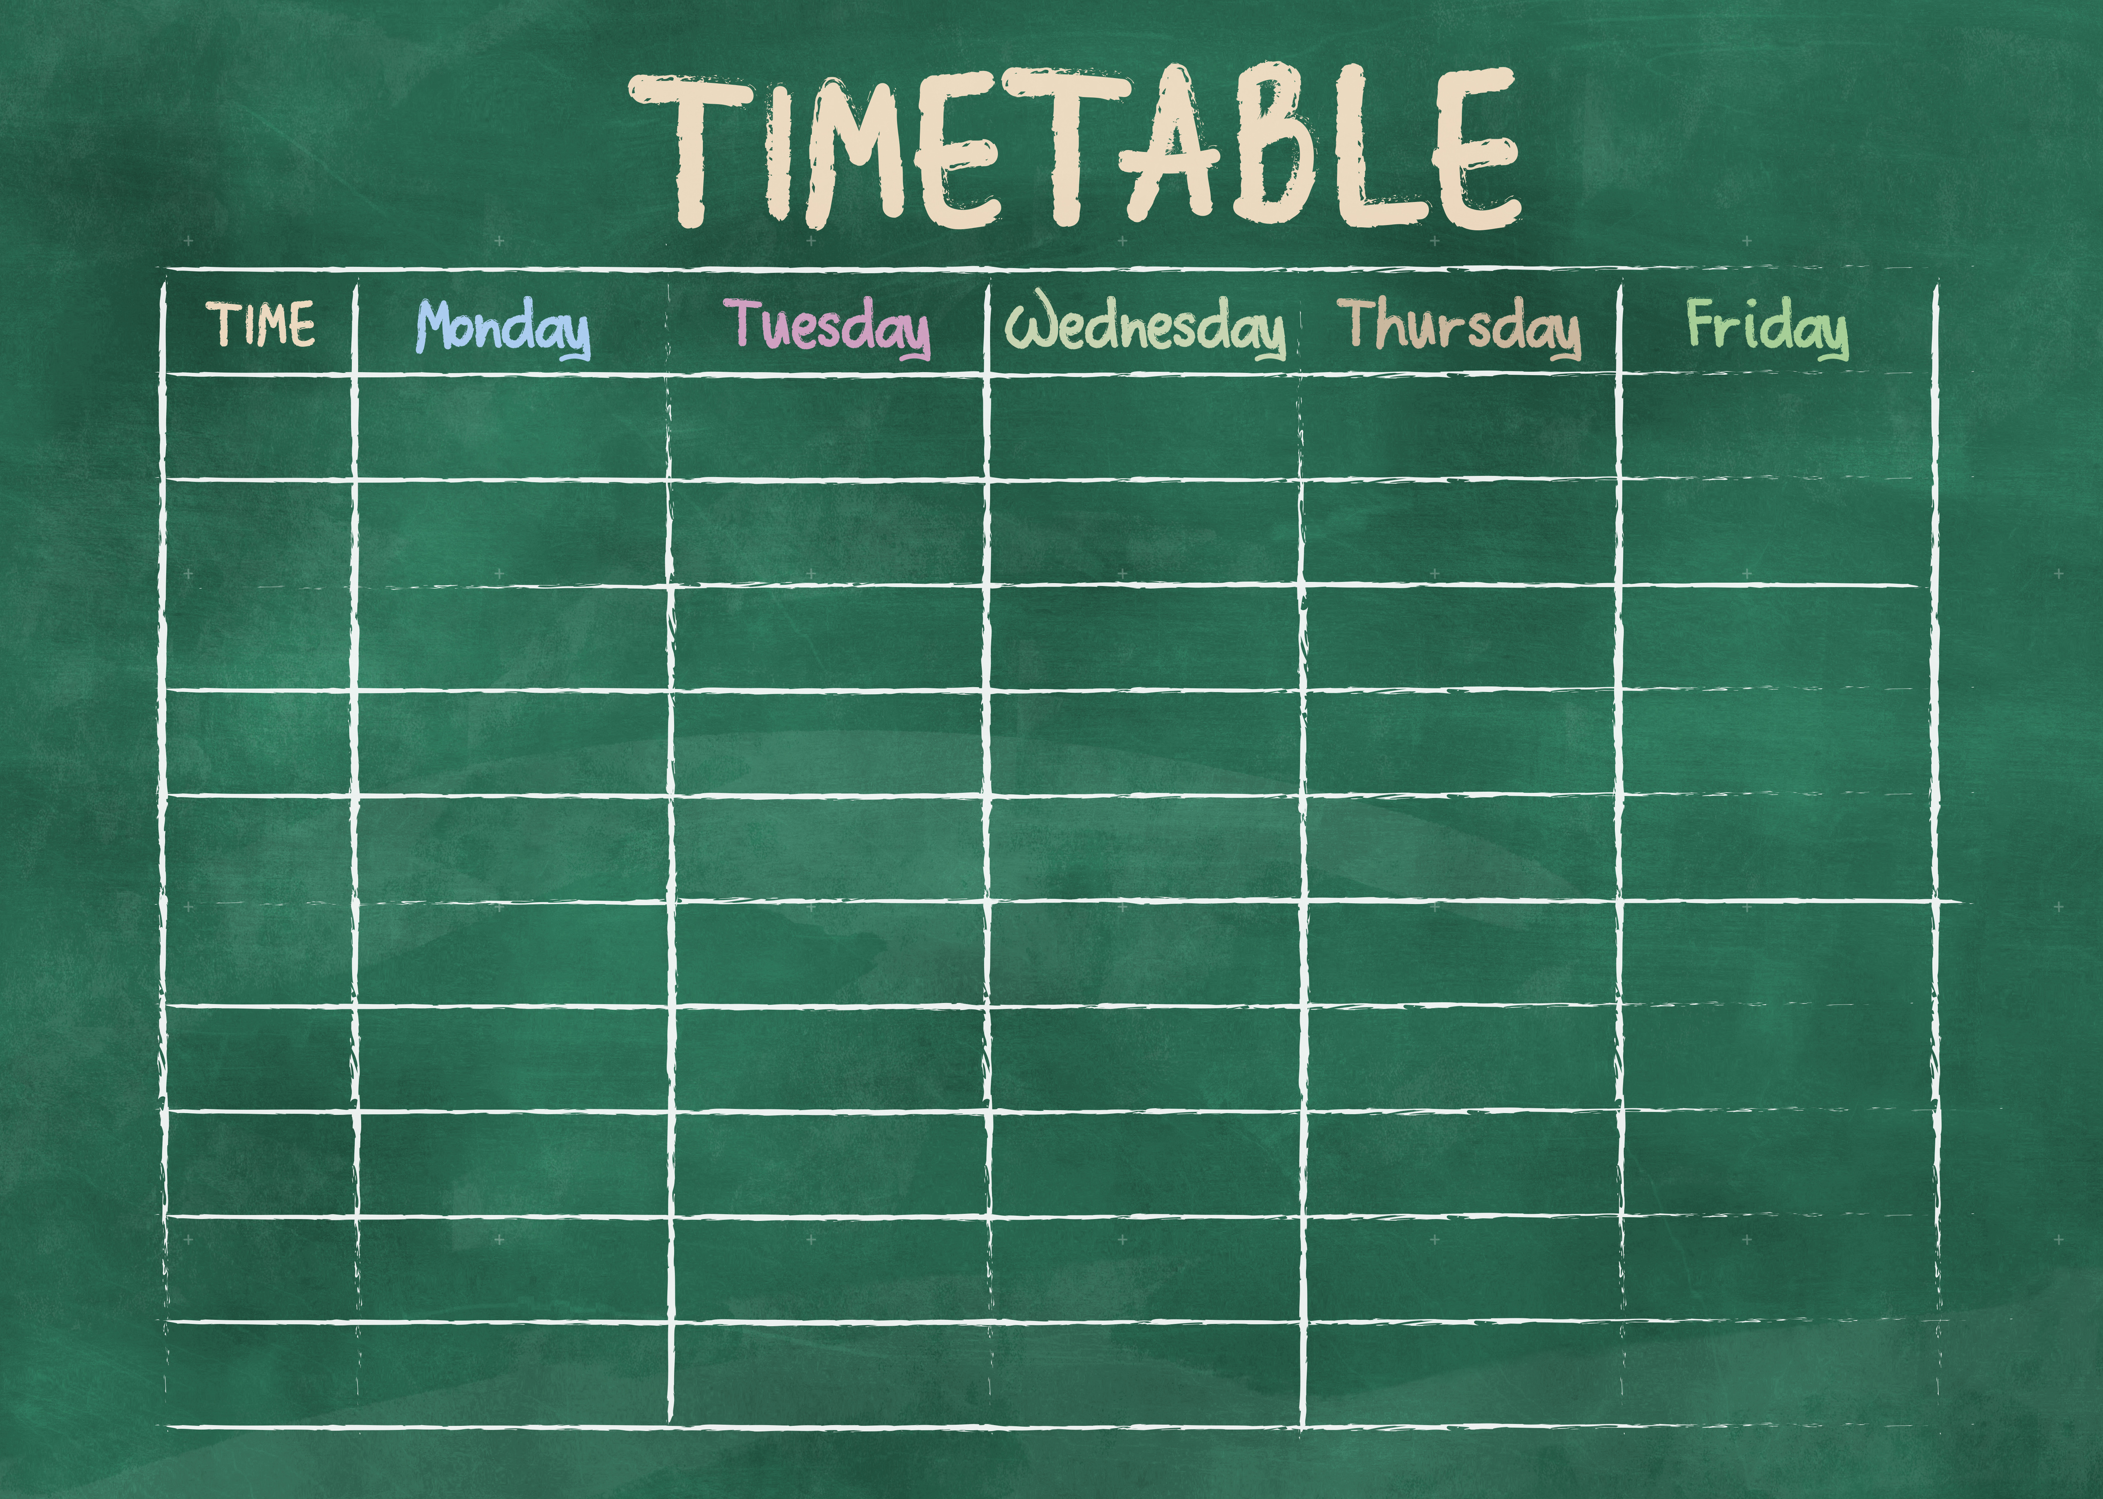
studyskillszone.co.uk
TREAT HALF TERM LIKE A
SCHOOL WEEK

Slide 7
studyskillszone.co.uk
GET AHEAD OF THE GAME
Those extra hours =
Higher grades
Less stress
More confidence
Fewer last-minute meltdowns

Slide 8
studyskillszone.co.uk
WHAT TO ACTUALLY DO
Don’t waste time re-reading notes
Know what you DON’T know
Make Q&A flashcards
Test yourself to spot gaps
NEVER REVISE without testing yourself

Slide 9
studyskillszone.co.uk
TAKE REGULAR BREAKS
Example
40min revision
10min break
5min test yourself
5min identify the gaps

Slide 10


studyskillszone.co.uk
MAKE HALF TERM WORK FOR YOU
studyskillszone.co.uk

