Slide 1

The magic of mocks
Turning practice into power
Notes:
Over the coming weeks you’ll hear a lot about mock exams - but today we’re looking at why they’re actually one of the most powerful parts of your preparation.
Mocks aren’t about pressure or punishment… they’re about progress. The more you treat them seriously, the calmer and more confident you’ll be when the real exams arrive.

Slide 2
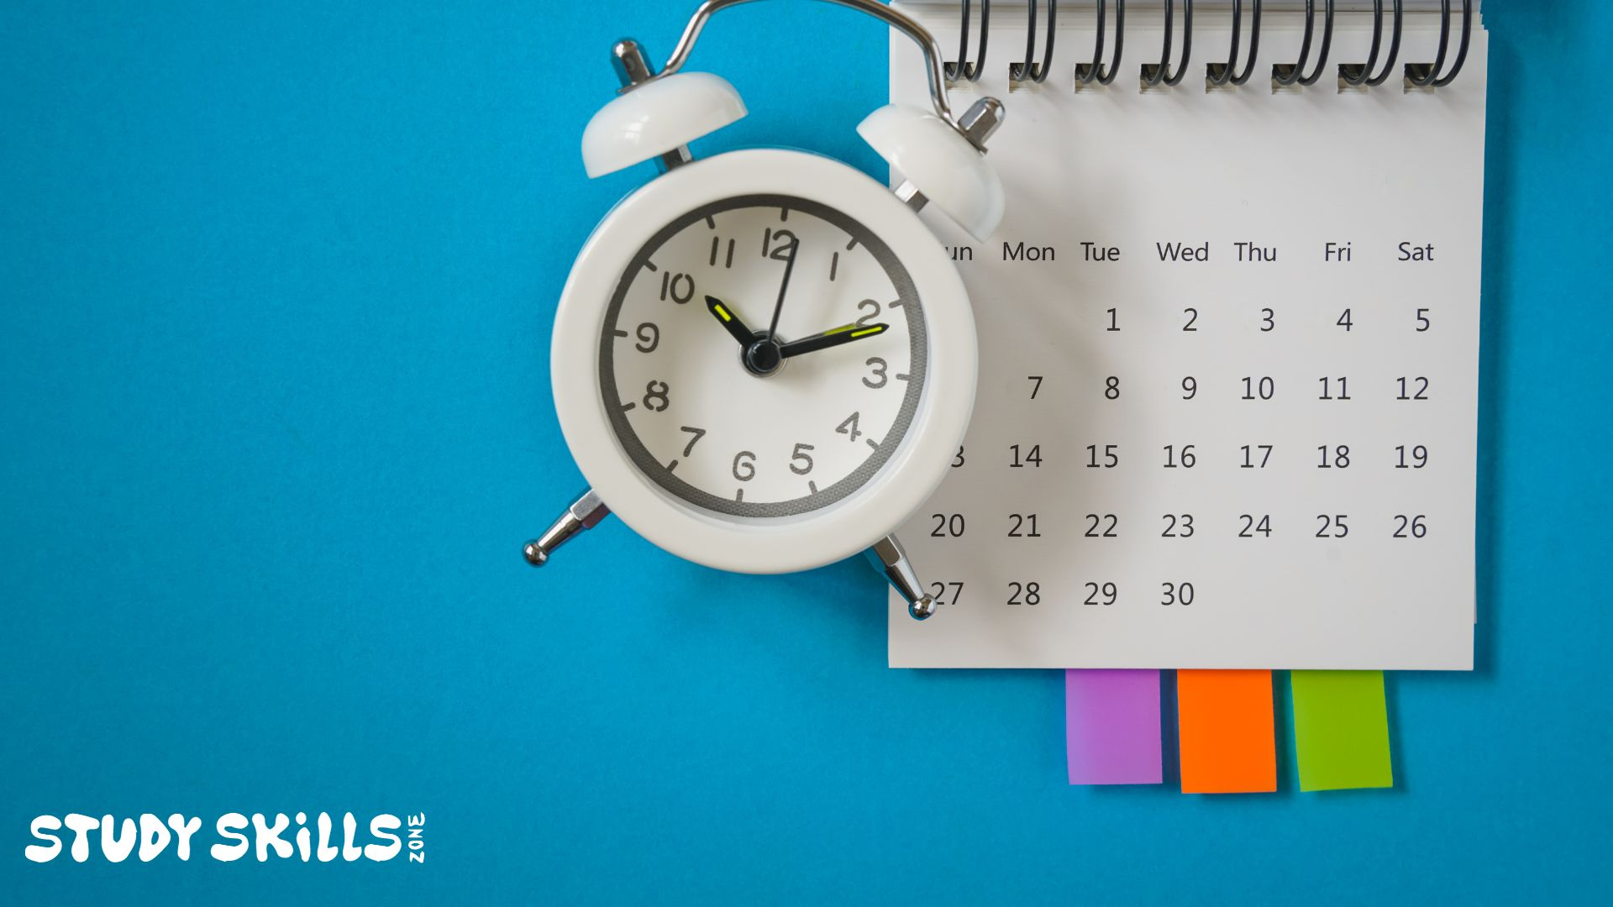
There’s still plenty of time
to prepare for your summer exams
But they're closer than you think.
6 months or roughly 180 days
NOV
→
DEC
→
JAN
→
FEB
→
MAR
→
APR
→
MAY
Notes:
Right now, you’re about six months from your GCSEs - roughly 180 days. It might sound like ages, but that time will fly by.
Your mocks show you what’s working and what needs attention while there’s still time to change it.

Slide 3

Why do mocks matter?
Because practice makes progress.
Notes:
Think of an athlete, a musician, or even a YouTuber - they all rehearse under real conditions.
Mocks give you the same chance: to test your timing, your focus, and your habits in real exam settings. Every paper you sit adds experience and confidence.

Slide 4

Do you want to get better?
Notes:
Do you want to get better?

Slide 5
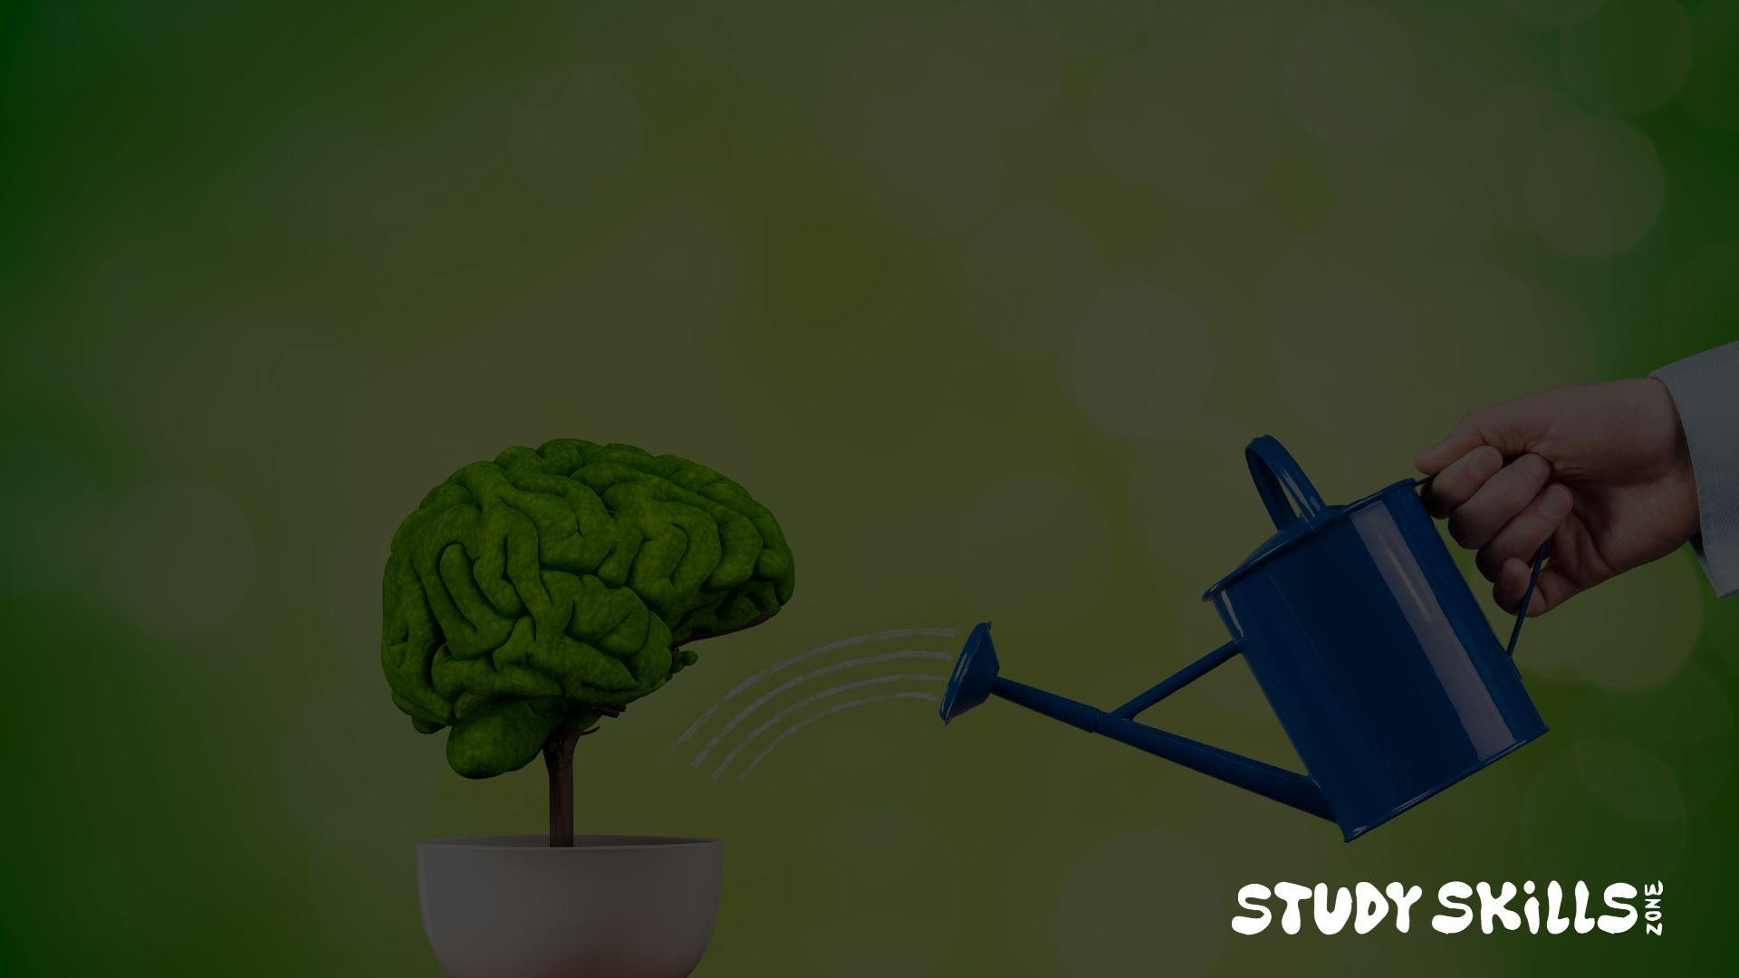
Playing the guitar?
Practise.
Basketball?
Practise.
Worried you’re not very good at exams?
Practise.
Notes:
Taking exams well is a skill - and like any skill, it improves with practice.

Slide 6





Taking practice exams helps you to...
Improve time
management
Understand command words
Reduce stress through familiarity
Identify
weak
topics
Notes:
Mocks help you understand how to pace yourself, recognise what exam questions are really asking, and build familiarity with the whole process. That familiarity is what removes the fear. They also help you to identify areas that need more work.

Slide 7

Time management
Read all the questions carefully at the beginning
Pay close attention to the mark scheme
Adjust how long you spend on each question relative to the number of marks it’s worth
Keep an eye on the clock
Check your answers at the end
Notes:
Try answering past papers to time. Set a start and finish, exactly like the real thing.

Slide 8

Command words
Understanding these words helps you to tailor your answer precisely to the question.
Describe
Explain
Compare
Evaluate
Analyse
Discuss
Identify
Justify
Outline
Calculate
Assess
Suggest
Notes:
Command words help you to give the answer the examiner is looking for.

Slide 9

Command words
Command words give instructions - but you have to notice them!
“Describe” means detail what you see.
“Explain” means give reasons for why or how something happens
“Evaluate” means weigh up pros and cons and reach a conclusion.
STUDY SKILLS ZONE
Notes:
Mock exams are an excellent chance to get used to spot command words and shaping your answers.

Slide 10
Command words
Where can you find a list of command words, their meanings, and videos explaining how to use them?
BBC Bitesize
Notes:
Type ‘command words’ into the search bar on the BBC Bitesize website to learn how to use them.

Slide 11

Practising under exam conditions
helps exams to feel less of an unknown
Notes:
The more times you sit in that exam hall, the more normal it feels.

Slide 12
Avoid catastrophising
Familiarity kills fear.
STUDY SKILLS ZONE
Notes:
Mocks stop your brain from going into panic mode. They take away the sense of “this is something terrifying” and replace it with “I’ve done this before - I know how this works.”

Slide 13

Spot the gaps
Mocks show what's missing...
that's their real magic.
Notes:
When you get your papers back, the marks you missed are gold dust. They show exactly what to fix.
You’re not meant to be perfect in mocks - you’re meant to learn where to focus your energy. That’s the whole point.

Slide 14

Think like a coach
Athletes analyse, learn, and improve
Notes:
When sports people have a bad match, they don’t say, “I’m rubbish.” They say, “Let’s see what went wrong.”
That’s how you should treat your mocks. Look for patterns - did you misread questions? Run out of time? Forget key facts? Each mistake gives you a clear next step.

Slide 15

Break the stress myth!
Mocks reduce stress, not increase it.
Notes:
People often think mocks add pressure, but in reality, they reduce it.
When you’ve rehearsed under the same conditions, the real exams feel familiar.
Your stress drops because your brain recognises what’s coming - it’s no longer the unknown.

Slide 16


Three steps to make mocks work for you
1
Treat them like the real thing
2
Review what went wrong — and why
3
Turn feedback into your next revision plan
STUDY SKILLS ZONE
Notes:
If you do these three things, you’ll get maximum benefit from the mocks. Take them seriously, reflect afterwards, and plan smarter revision based on what you learned. That’s how you turn feedback into results.

Slide 17

Don’t fear the mocks!
Use them as a stepping stone
to higher grades.
www.studyskillszone.co.uk
Notes:
You’ve got a real chance now to shape how the next few months go.
Mocks are your chance to learn how you perform and build confidence for the real thing.
Finish strong, and your ‘future self’ will thank you.

