Slide 1

Willpower is overrated
Why systems beat motivation every time
Based on ‘Atomic Habits’ by James Clear
Notes:
Welcome everyone. Today we're going to challenge something you've probably been told your whole life - that success comes down to willpower and motivation. The truth? That's only part of the story. James Clear, author of Atomic Habits, has shown us that the real secret isn't about trying harder - it's about building better systems. This matters especially for you as GCSE students because you're facing months of revision, exams, and pressure. Let's talk about how to make it easier, not harder.

Slide 2
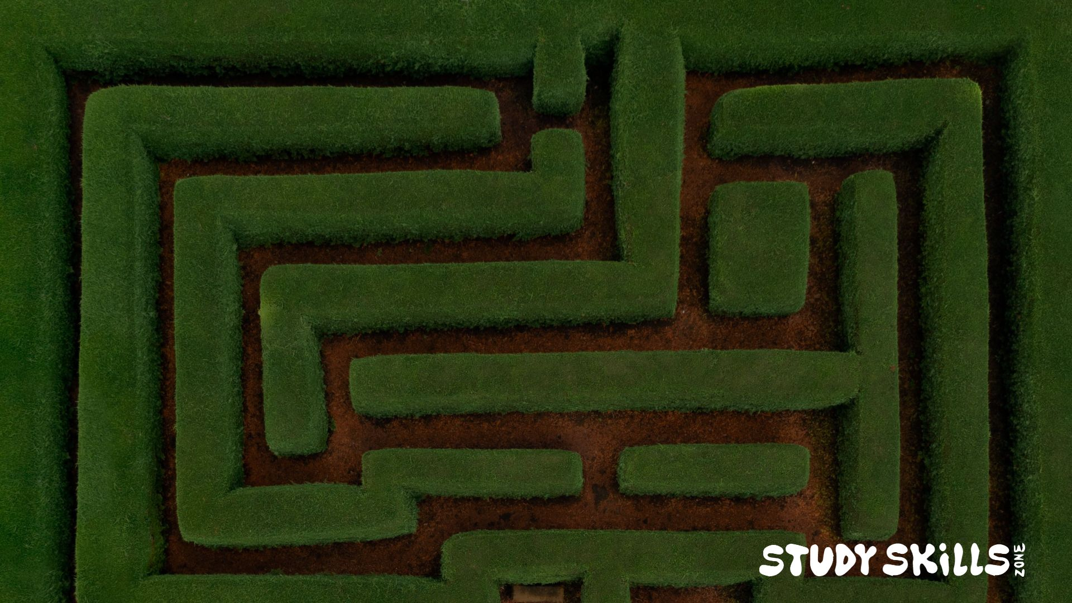
The problem with relying on motivation:
Some days you'll feel motivated.
Some days you won’t.
Notes:
Here's the reality: motivation is unreliable. Think about it - have you ever set your alarm to exercise or study at 6am, felt super motivated the night before, then when morning comes... nothing? That's normal. Motivation comes and goes like the weather. You can't control it.

Slide 3

If your success depends on feeling motivated,
you’re setting yourself up for failure.
Notes:
Research shows that motivation naturally fluctuates based on sleep, stress, mood, even what you ate for breakfast. If your entire revision strategy depends on "feeling like it," you're setting yourself up for failure. The students who succeed aren't more motivated - they've just stopped relying on motivation altogether.

Slide 4

"You do not rise to the level of your goals.
You fall to the level of your systems."
James Clear, Atomic Habits
STUDY SKILLS ZONE
Notes:
This quote is absolutely crucial. Everyone has goals - "I want to get a grade 7 in Maths" or "I want to pass my GCSEs." Goals are easy. But when exam pressure hits, when you're tired, when Netflix is calling - you don't rise up to meet your goals through sheer willpower. Instead, you fall back to whatever systems you've built.

Slide 5

Your goals are about where you want to go.
Your systems are about how you'll get there.
Notes:
Having goals and having systems to achieve goals are not the same thing.

Slide 6

What's the difference?
Goals
Systems
"I want to get a grade 7 in maths"
•
"I study Maths for 30 minutes every day after dinner"
•
"I keep my phone in another room when studying"
"I want to be more focused"
•
•
STUDY SKILLS ZONE
Notes:
Let's get practical. Goals tell you what you want. Systems tell you what to do. "I want better grades" is a goal - it's vague and doesn't tell you what to do tomorrow. "I do 30 minutes of practice questions every day at 4pm" is a system - it's specific, repeatable, and doesn't require motivation. Here's the key insight: winners and losers have the same goals. Every student wants good grades. The difference is the system.

Slide 7
What's the difference?
Systems are
repeatable
processes
that run on
autopilot
Goals require
constant
motivation
STUDY SKILLS ZONE
Notes:
A goal is saying "I want to be fit." A system is going to the gym every Monday, Wednesday, Friday at 6pm. See the difference? One requires you to feel motivated. The other just requires you to follow the pattern you've already established.

Slide 8

Your environment shapes your behaviour
Make good choices automatic.
Make bad choices harder.
Notes:
This is where it gets really practical. James Clear talks a lot about environment design, and it's a game-changer. Your willpower is limited - it runs out. But your environment works 24/7.

Slide 9



Phone in another room = less distraction
Desk cleared = easier to start studying
Revision materials visible = reminder to study
Notes:
These practical changes mean you’re not changing your willpower. You're changing the environment to make the right choice the easy choice.

Slide 10
Use triggers to build automatic habits
Formula:
When [TRIGGER], I will [ACTION]
When I get home from school, I review today's notes for 10 minutes
•
When I finish dinner, I do one past paper question
•
When I sit at my desk, I put my phone in the drawer
•
Notes:
This is one of the most powerful tools from Atomic Habits - the habit trigger formula. Your brain loves patterns. When you link a new habit to an existing trigger, you make it automatic. The formula is simple: "When X happens, I do Y." For example, "When I get home from school" is a trigger that happens every day. If you link it to "I review today's notes for 10 minutes," you've created a system. After a few weeks, you won't even think about it - you'll just do it. That's the power of triggers. You're not relying on motivation. You're relying on pattern recognition, which your brain does automatically. The key is to pick triggers that already happen in your life, then attach the behavior you want to build.

Slide 11

The 2-Minute Rule
When starting a new habit, it should take less than 2 minutes.
"Study for 3 hours"
“Put two bullet points
on a flashcard"
"Revise all of Chemistry"
"Read one page of notes"
Notes:
This is brilliant and counterintuitive. When you're building a new habit, the goal isn't to do the whole thing - it's just to show up. James Clear calls this the 2-Minute Rule. Make the first step so small that it takes less than two minutes and feels almost silly. Why? Because starting is the hard part. Once you've opened your textbook, you'll probably read more than one page. The genius is that you're building the habit of showing up. The duration comes later. First, make it automatic to start.

Slide 12
Your phone is designed to beat your willpower
Social media companies employ hundreds of engineers to make their apps addictive. You can't out-willpower that.
Solution: Change the system
•
Delete apps during exam season
•
Use app timers
•
Keep phone in another room while studying
•
Turn off all notifications
Notes:
Let's be real about something: your phone is your biggest enemy when it comes to studying. And it's not your fault. Snapchat, Instagram, TikTok - these apps are designed by some of the smartest engineers in the world with one goal: keep you scrolling. They use psychological tricks, algorithms, and notifications specifically designed to be impossible to ignore. You cannot beat that with willpower. You just can't. So stop trying. Instead, change the system. If you're serious about your GCSEs, delete social media apps during exam season. I know that sounds extreme, but you can reinstall them in July. Or use app timers to limit yourself to 30 minutes a day. Or keep your phone physically in another room. These aren't willpower solutions - they're system solutions. You're not fighting your impulses. You're removing the temptation entirely.

Slide 13
Build new habits onto existing ones
Formula:
After [CURRENT HABIT], I will [NEW HABIT]
After I brush my teeth at night, I'll lay out tomorrow's revision materials
•
After I eat lunch, I'll do 10 minutes of flashcards
•
After I finish one subject, I'll take a 5-minute walk before starting the next
•
Notes:
Habit stacking is another genius concept from Atomic Habits. You already have dozens of habits - brushing your teeth, eating meals, getting dressed. These are automatic. So instead of creating a new habit from scratch, stack your new habit onto an existing one. "After I brush my teeth" is something you already do every night. If you add "I'll lay out tomorrow's revision materials," you're piggybacking on an established routine. This works because your brain already has the neural pathway for the first habit. You're just extending it. The key is to be specific. Not "sometime after school" but "after I eat lunch." Not "when I remember" but "after I finish one subject." Specificity creates automaticity.

Slide 14
Build your system today
1
Choose one trigger
(e.g., "When I get home from school...")
2
Pick one tiny habit
(e.g., "...I'll review today's notes for 10 minutes")
3
Design your environment
(e.g., keep revision materials visible, phone in another room)
4
Track it
(e.g., tick a calendar every day you do it)
STUDY SKILLS ZONE
Notes:
Let's make this actionable. You're going to leave here today and build one system. Just one. Not ten. One. Here's how: First, pick a trigger that already happens in your daily life. "When I get home." "After dinner." "When I sit at my desk." Second, attach the smallest possible version of the habit you want to build. Not "study for 2 hours" - that's too big. “Make two flashcards." Third, set up your environment to make it easy. Put your revision materials somewhere visible. Remove distractions. Fourth, keep track of your new habits.

Slide 15

Stop waiting for motivation
You don't need more willpower.
You need better systems.
studyskillszone.co.uk
Notes:
If you have a goal, just build one system that’s a step towards that goal. And do it today. Then build another system and another.

