Slide 1
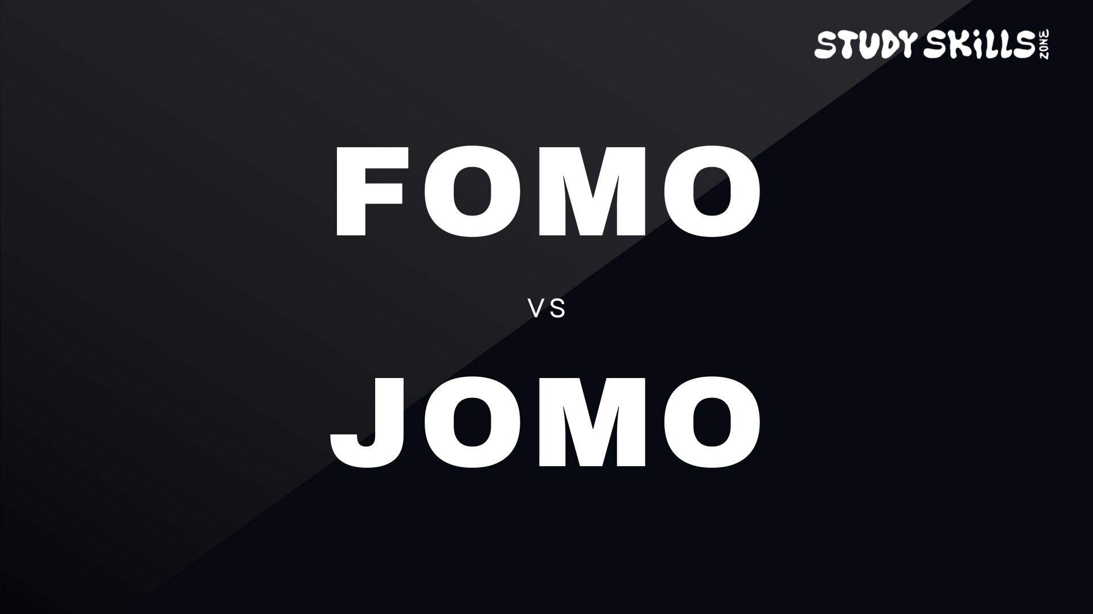
How choosing your priorities now can help you achieve your dreams
www.studyskillszone.co.uk

Slide 2

The Fear Of Missing Out
Feeling anxious about missing online content or social events
Leads you towards others’ priorities instead of your own
Can steal time from studying and personal growth
Visual suggestion: Teen doomscrolling while books remain untouched
www.studyskillszone.co.uk

Slide 3

The Joy Of Missing Out
Choosing to focus on your own goals and priorities
Using free time for study, revision, or personal projects
Leads to skill growth, confidence, and long-term achievement
Taking downtime to relax and enjoy your own company
Visual suggestion: Teen studying in calm environment
www.studyskillszone.co.uk

Slide 4

How FOMO affects your studies
Saying yes to every social event instead of studying
Doom scrolling instead of completing homework or revision
Feeling hopeless through relentlessly comparing yourself to others
www.studyskillszone.co.uk

Slide 5

How JOMO supports your goals
Choosing to focus on your exams or coursework
Prioritising your own learning over social comparison
Using evenings and weekends productively (and taking time to relax)
Visual suggestion: Student with a planner
www.studyskillszone.co.uk

Slide 6
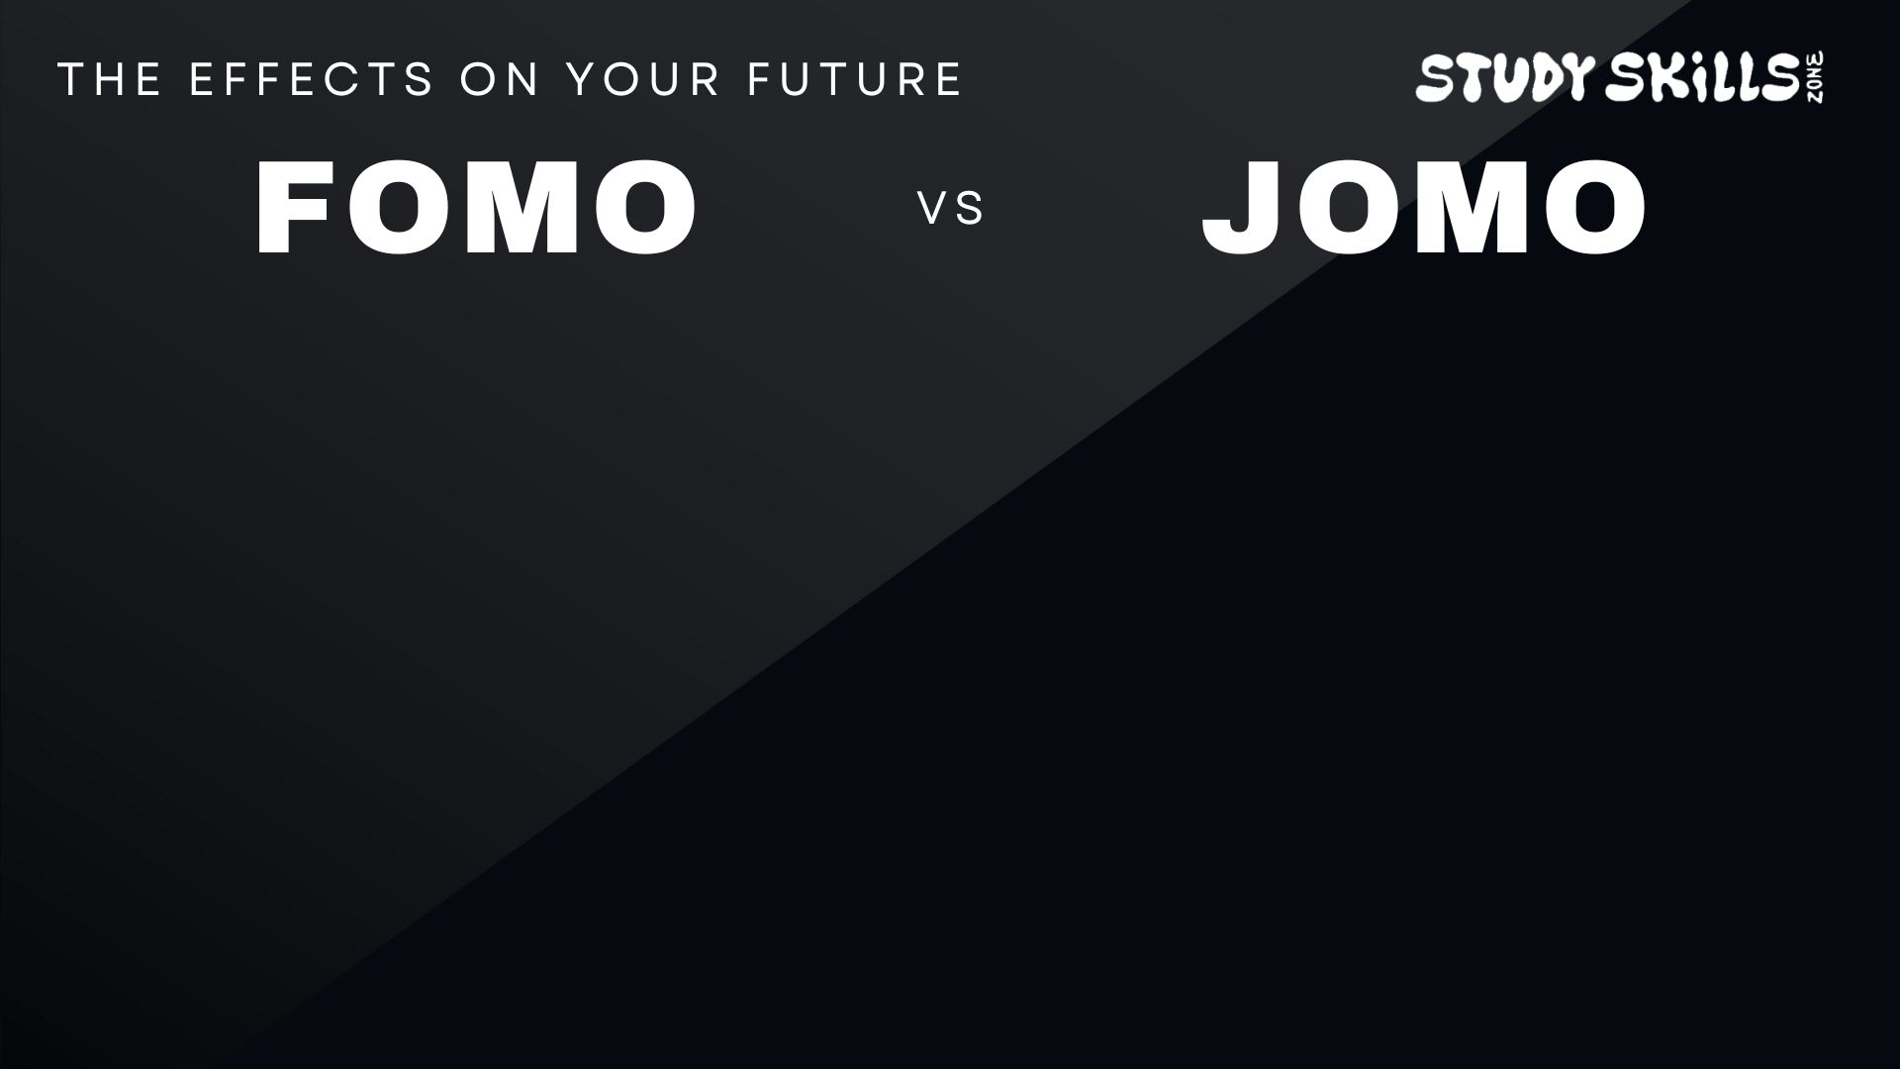
Short-term choices, Long-term rewards
FOMO | JOMO
Time wasted on others' priorities | Time invested in your own goals
Stress and distraction | Focus and skills growth
Missed deadlines & lower grades | Improved grades & confidence
Following others' dreams | Building your own path
Visual suggestion: Timeline showing from now to future successes
www.studyskillszone.co.uk

Slide 7

Using study time wisely
Every day gone is an opportunity
you can’t get back
FOMO distracts you
JOMO invests in your future success
Small, consistent focus now = big rewards later
Visual suggestion: Diamonds and books
www.studyskillszone.co.uk

Slide 8
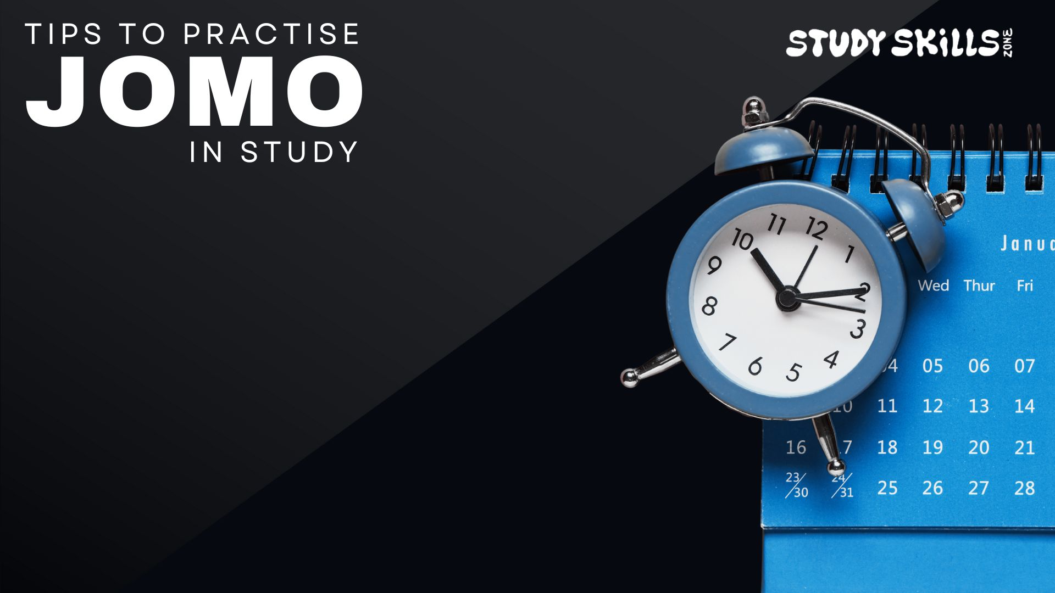
Make your study time count
Schedule focused study time and protect it from distractions
Turn off notifications while working
Set clear goals for each session
Reflect on how today’s choices move you closer to your goals
Visual suggestion: Planner/calendar showing study periods
www.studyskillszone.co.uk

Slide 9
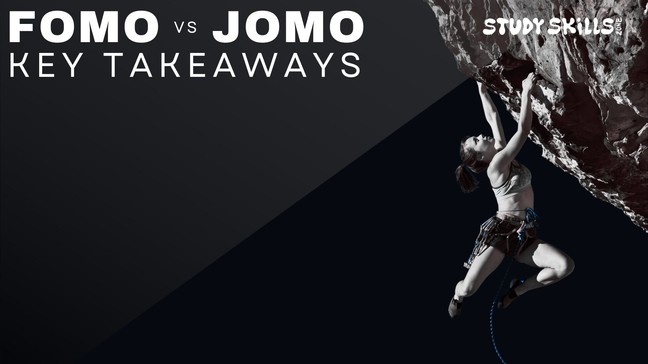
FOMO = chasing other people’s priorities
JOMO = Investing in your own
long-term growth and dreams
Each study session now builds skills and confidence for the future
www.studyskillszone.co.uk

Slide 10

“We must all suffer from one of two pains: the pain of discipline or the pain of regret. The difference is discipline weighs ounces while regret weighs tons.”
Jim Rohn
“Acres of Diamonds lie under our feet, but we never dig them up.”
Russell H. Conwell
www.studyskillszone.co.uk

Slide 11


