Slide 1



Make the most of your
Christmas holidays
How to rest, revise, and return stronger
studyskillszone.co.uk
Helping students prepare, perform and progress.

Slide 2
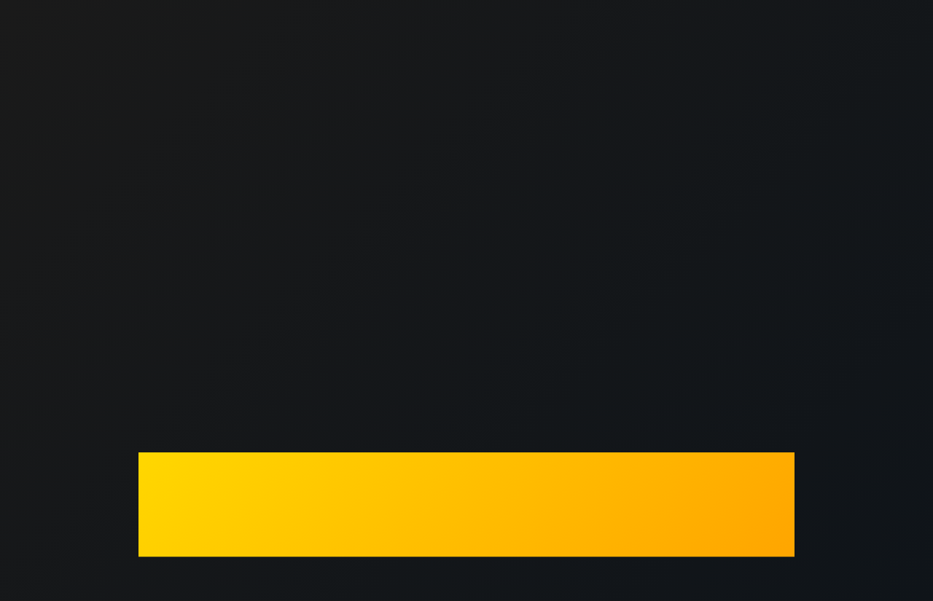
The Christmas Dilemma
Helping students prepare, perform and progress.
01
You've earned a break!
02
January/February mocks are around the corner
03
Two weeks can disappear fast
Balance is key: rest and recharge without losing momentum

Slide 3
You still have time to make a difference
Helping students prepare, perform and progress.
01
20 weeks to go
02
No need to panic
03
Steady progress across 20 weeks = less stress later
Spread out the workload!

Slide 4
The time left…
Helping students prepare, perform and progress.
2-week Christmas holiday
6 weeks of school
1 week half term
5 weeks of school
2-week Easter holiday
4 weeks of school (study leave?)

Slide 5

The Golden Rule
Helping students prepare, perform and progress.
You don't need to work all day
You just need to work smart

Slide 6
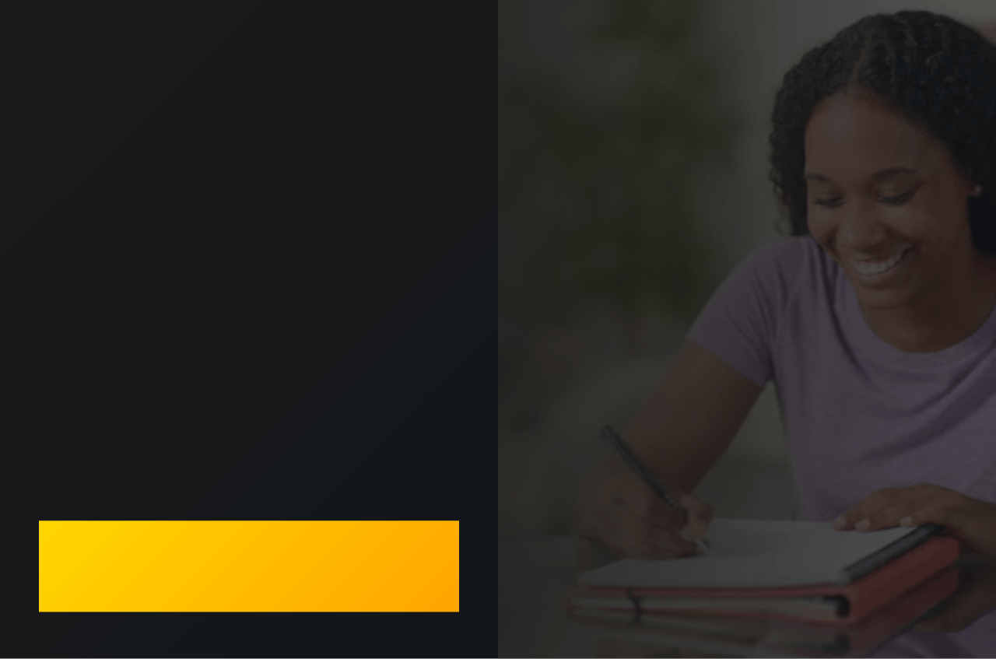

Plan It Like a
School
Week
Routine
Set regular study times
Breaks
Schedule rest, rewards, and down time
It’s a balancing act!
Stick to a revision timetable
Helping students prepare, perform and progress.

Slide 7


Focus on what you
don't know (yet)
Smart revision means targeting gaps in knowledge
01
Review recent test feedback
02
Identify weak topics or skills
Prioritise areas that need
the most work
03
Helping students prepare, perform and progress.
Study Skills
Zone

Slide 8

The 3 Rs strategy
REST
REVISE
REWARD
Sleep well
Short sessions
Treat yourself
Relax
Focus on one topic at a time to
avoid becoming overwhelmed
See friends & family
Recharge
Test yourself
Plan time for fun activities
Study Skills
Zone
Helping students prepare, perform and progress.

Slide 9
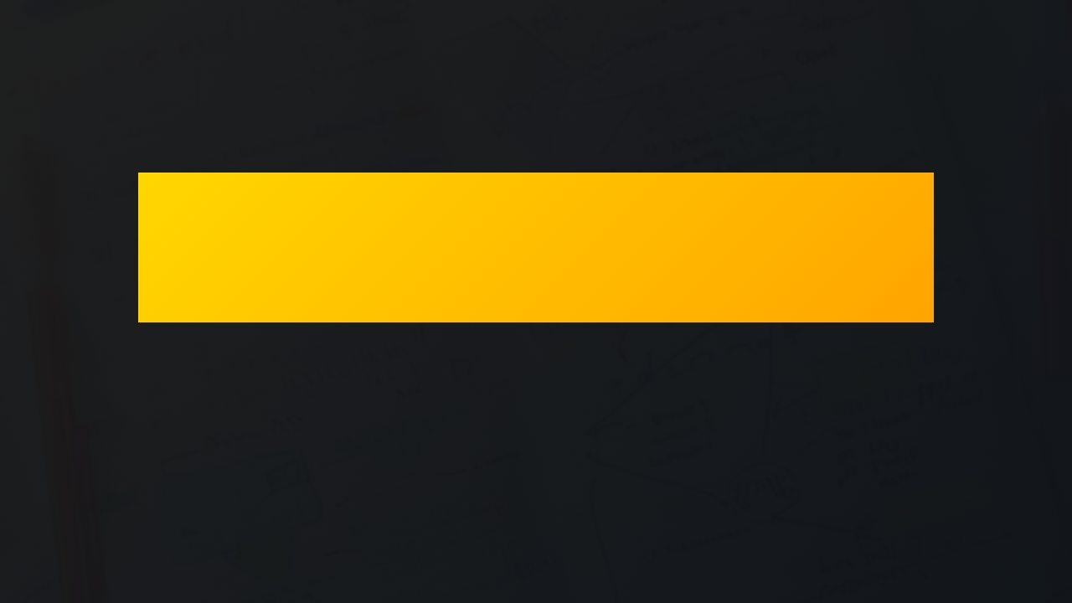
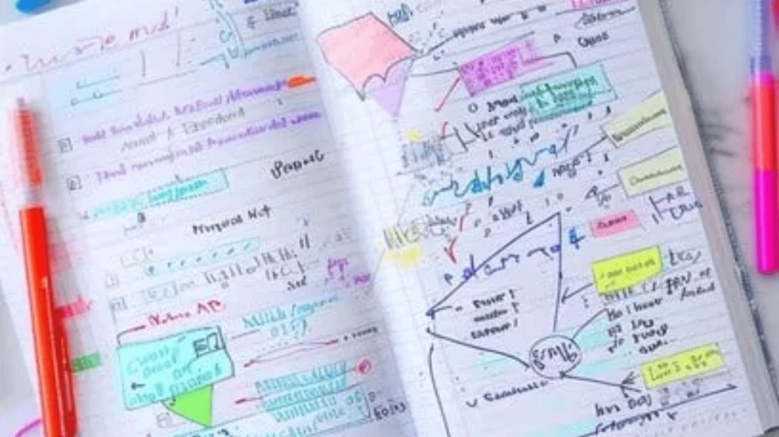
Smarter
, Not Longer
Active revision sticks... passive reading doesn't
It’s important to structure challenges into the revision process.
Helping students prepare, perform and progress.

Slide 10

Active Revision
Techniques
Helping students prepare, perform and progress.
01
02
Q&A Flashcards
Brain dump
Test yourself on key facts and definitions
Write everything you can remember
about a topic onto a blank piece of paper
03
04
Peer Quizzing
Past Papers
Quiz with friends or family
Practice under timed conditions

Slide 11

Start the New Year ahead of the game
01
Feel confident going into Jan/Feb mocks
02
Less panic in the spring term
03
Better grades and less stress
Pace yourself!

Slide 12

Your holiday goal
What will you commit to this Christmas?
A
2 hours of revision on average per day?
B
Complete 5 past papers?
C
Master two of my weakest topics?
Helping students prepare, perform and progress.

Slide 13

Key
Takeaways
01
02
Balance rest and revision - you need both
Plan your time and stick to a routine
03
04
Focus on weak areas, not what you already know
Use active revision techniques that force you to think!
Helping students prepare, perform and progress.

Slide 14


Good Luck in the spring and summer term!
You've got this!
studyskillszone.co.uk
Helping students prepare, perform and progress.

