Slide 1



Coincides with the start of exam season
MENTAL HEALTH AWARENESS WEEK
Mon, 10th May 2027 – Sun, 16th May 2027
www.StudySkillsZone.co.uk
Notes:
“Welcome everyone. This presentation is especially relevant right now – it’s exam season, and it’s also Mental Health Awareness Week. It’s the perfect time to talk about sleep, wellbeing, and how they link directly to exam success.”

Slide 2

3 CORNERSTONES OF EXAM SUCCESS
Putting in the hours of revision
Using effective revision techniques
e.g. Self-testing, Spacing out reviews
Maintaining wellbeing
through the exam period
www.StudySkillsZone.co.uk
Notes:
Success in exams comes down to three key things: the time you put in, using effective revision techniques, and crucially – maintaining your wellbeing. Today, we’re going to focus on connection between sleep and well being.

Slide 3

The focus of this presentation is well-being -
in particular sleep
www.StudySkillsZone.co.uk
Notes:
We’re not here to add pressure. Instead, this is about helping you look after yourself during a demanding time – and that starts with getting good sleep.

Slide 4

BUT MANAGING OUR WELLBEING ISN’T ALWAYS EASY
Jack Kornfield quote
“If you can sit quietly after difficult news; if in financial downturns you remain perfectly calm; if you can see your neighbours travel to fantastic places without a twinge of jealousy; if you can happily eat whatever is put on your plate; if you can fall asleep after a day of running around without a drink or a pill; if you can always find contentment just where you are…
www.StudySkillsZone.co.uk
Notes:
This quote from Jack Kornfield makes a brilliant point – managing our wellbeing can be tough! If you’re struggling with focus, emotions, or switching off - you’re not alone.

Slide 5

…YOU ARE PROBABLY A DOG.”
www.StudySkillsZone.co.uk

Slide 6

PILLARS OF WELL-BEING
Good
Nutrition
www.StudySkillsZone.co.uk
Notes:
Although sleep is the focus of this talk, it’s only one of the pillars of wellbeing. Let’s quickly look at all 6 pillars before we look deeper into sleep. Let’s start with food. What you eat makes a big difference to how you feel and function. During exam time, try to eat well – regular meals, not too much sugar, and stay hydrated. Your brain works better when it’s properly fuelled. On exam days, slow-release carbohydrates, such as porridge are better than sugary cereals.

Slide 7
PILLARS OF WELL-BEING
Good
Nutrition
Exercise
www.StudySkillsZone.co.uk
Notes:
Exercise is next. You don’t need to run marathons – just getting out for a walk or a run, doing some stretching, sport, dancing, or moving your body regularly can boost your mood and help you concentrate. Even a short burst of activity can clear your head.

Slide 8
PILLARS OF WELL-BEING
Good
Nutrition
Exercise
Sleep
www.StudySkillsZone.co.uk
Notes:
Sleep is what this whole session is about. It supports your mental health and keeps your energy levels steady. If you’re not sleeping well, everything else feels harder.

Slide 9
PILLARS OF WELL-BEING
Good
Nutrition
Exercise
Sleep
Relaxation
www.StudySkillsZone.co.uk
Notes:
Relaxation means switching off properly. Not just scrolling through social media but actually giving your mind a break – listening to music, reading a book, mindfulness, or even just sitting quietly. Sticking to a study planner helps too. When you’re revising, give your full attention to your work, and then when revision is over, intentionally slow down and unwind. Finding the right way to relax for you will help to bring your stress levels down.

Slide 10
PILLARS OF WELL-BEING
Good
Nutrition
Manage your thinking
Exercise
Sleep
Relaxation
www.StudySkillsZone.co.uk
Notes:
This one’s about what’s going on in your head. We all have unhelpful thoughts sometimes. And when times are stressful, it’s easy to start catastrophising – ‘I’m going to fail’, or ‘I’m never going to be a success’ – how you respond to these thoughts matters! Try to recognise your most common negative thoughts and see them as passing clouds instead of hard truths. Meditation and mindfulness apps can help you to manage your thinking.

Slide 11
PILLARS OF WELL-BEING
Good
Nutrition
Manage your thinking
Exercise
Sleep
Relaxation
Relationships
www.StudySkillsZone.co.uk
Notes:
Finally, stay connected. When you’re stressed, it’s easy to shut yourself off. But talking to someone – a friend, family member, teacher – even for a few minutes, can really help. It’s also important to make time in your revision schedule to hang out with your friends and have fun! You don’t have to go through exam season on your own.

Slide 12

“THERE IS A BI-DIRECTIONAL RELATIONSHIP BETWEEN SLEEP AND MENTAL HEALTH.”
www.StudySkillsZone.co.uk
Scott, A. J., Webb, T. L., & Rowse, G. (2017)
Notes:
Now, Let’s return to the main focus of this talk - sleep. Research into sleep shows something really important – when we sleep better, we tend to cope better with mental health. And when our mental health is good, we sleep better. The two are deeply connected.

Slide 13
SLEEP WELL
BECOMES EASIER TO MANAGE MENTAL HEALTH
BECOMES EASIER TO SLEEP WELL
BECOMES EASIER TO MANAGE MENTAL HEALTH
ETC
www.StudySkillsZone.co.uk
Notes:
Here’s the positive spiral: better sleep helps us feel mentally stronger, which helps us sleep better.

Slide 14

UNFORTUNATELY, THE REVERSE CAN ALSO BE TRUE.
Poor sleep can make it harder to manage our mental health which makes it harder to sleep, etc.
www.StudySkillsZone.co.uk
Notes:
But unfortunately, if we struggle with sleep, it can work the other way around too.

Slide 15
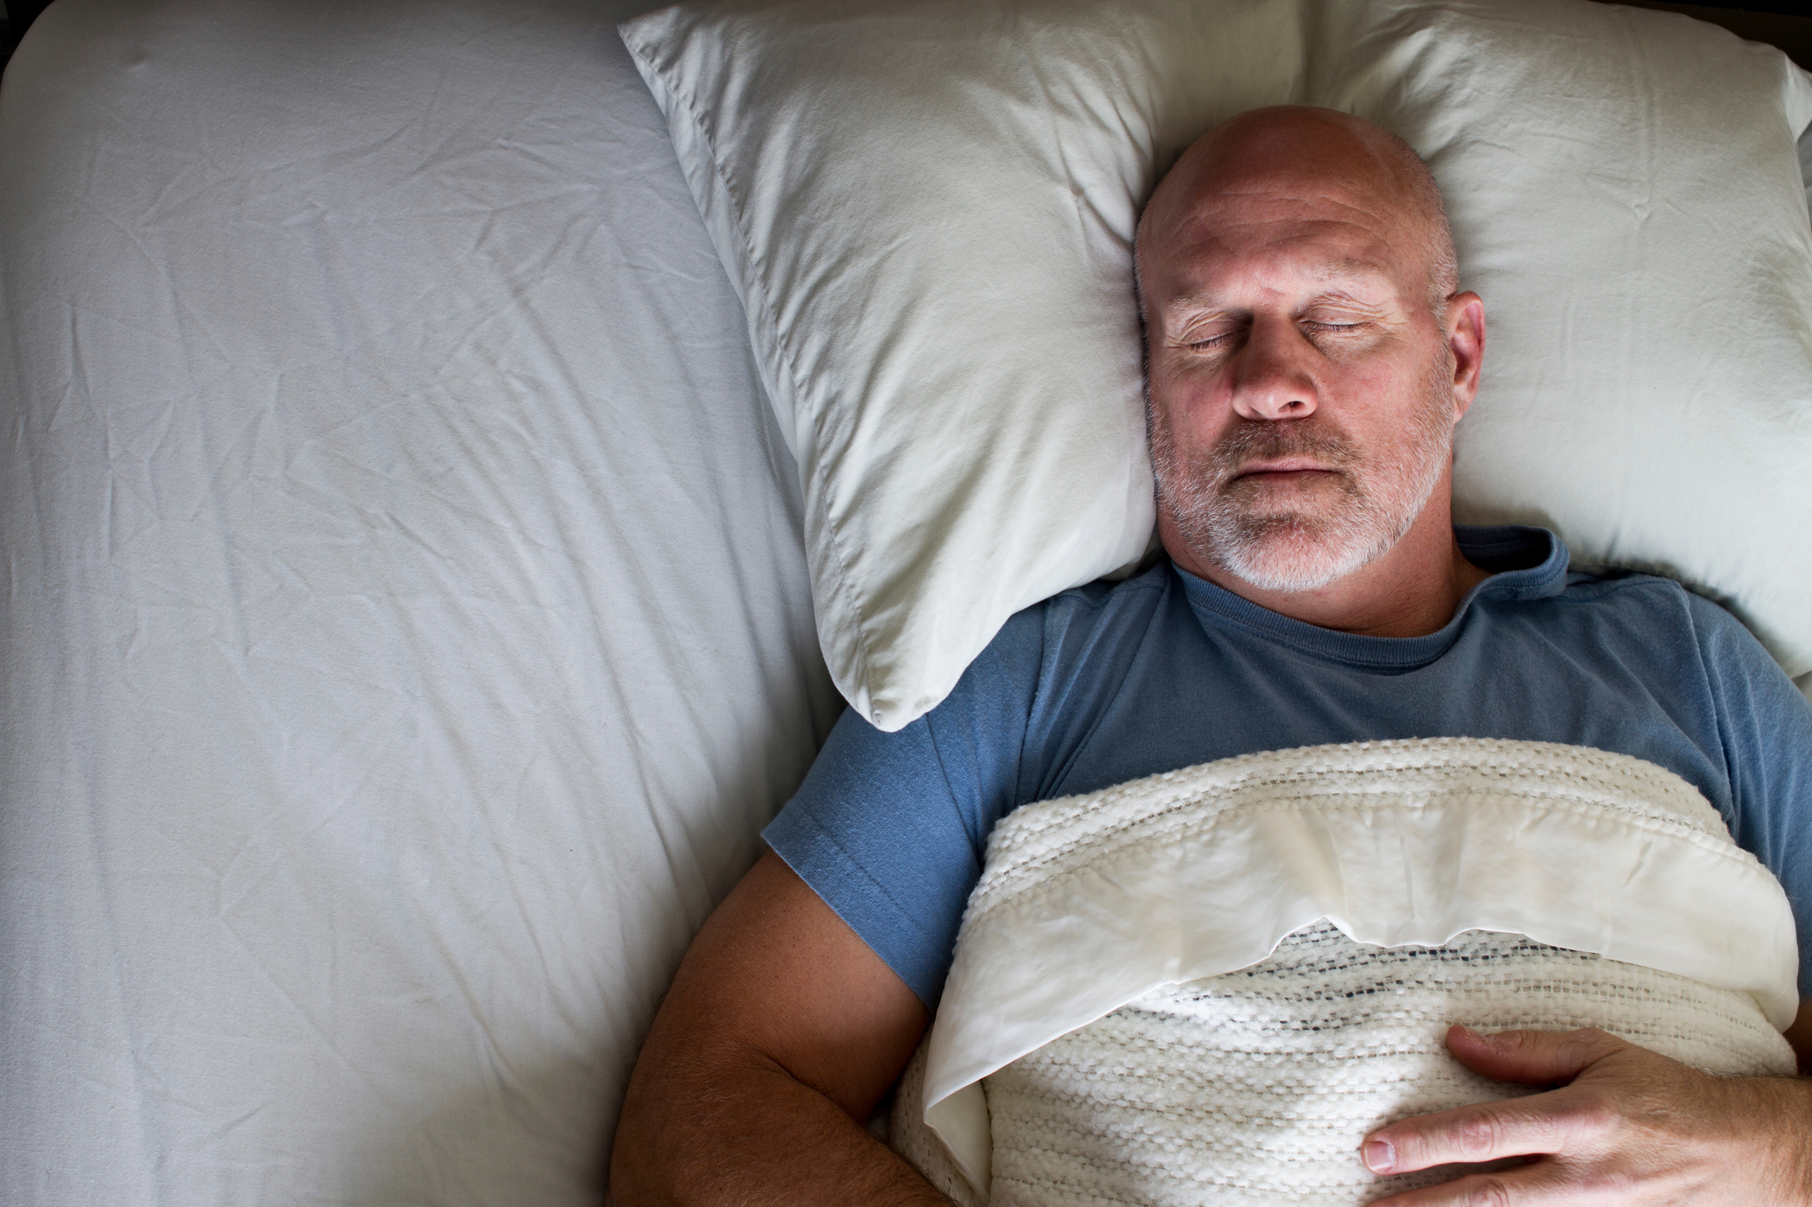
What can we do to improve our sleep?
Let’s investigate through the eyes of someone who has recently become a parent…
www.StudySkillsZone.co.uk
Notes:
But what can we do to improve our sleep?

Slide 16

Why do parents work hard to get their children to sleep?
1. For the health and wellbeing of the child
2. For their own sanity!
child that sleeps well
time for parent
to sleep / relax
/ tidy up, etc.
=
www.StudySkillsZone.co.uk
Notes:
Parents go to great lengths to help babies and toddlers sleep well – and it’s not just for the child’s benefit. It’s so the parent can function too! That tells us something about how vital sleep is for everyone.

Slide 17
What parents do to help their toddlers/children to sleep*
What (some) parents do to disrupt their own sleep
  No sugary foods before bedtime
  Same time to bed every night
  Predictable wind-down routine: bath, changing into night clothes etc.
  No screens in the hour before bedtime
  Read a bedtime story
  Dim the lights in the room to create a calm atmosphere
  Singing a lullaby or having a wind-up musical mobile
  Don’t play with baby/toddler when they’re in bed & keep your voice quiet
  Eat sugar foods and drink stimulants before bed
  Go to bed at random times
  No wind-down routine e.g. shower/bath/reading
  Work late or look at emails right up until bedtime
  Look at screens in bed rather than reading a book
  Don’t dim lights or create calm atmosphere
  Play loud video games / watch loud films before bed
*Source: www.nhs.co.uk ‘helping your baby to sleep’
& ‘sleep and young children’.
Notes:
Here’s the irony – we follow all the rules for toddlers and children but break every one for ourselves! This comparison is a good reminder that many of us sabotage our own sleep without meaning to.

Slide 18
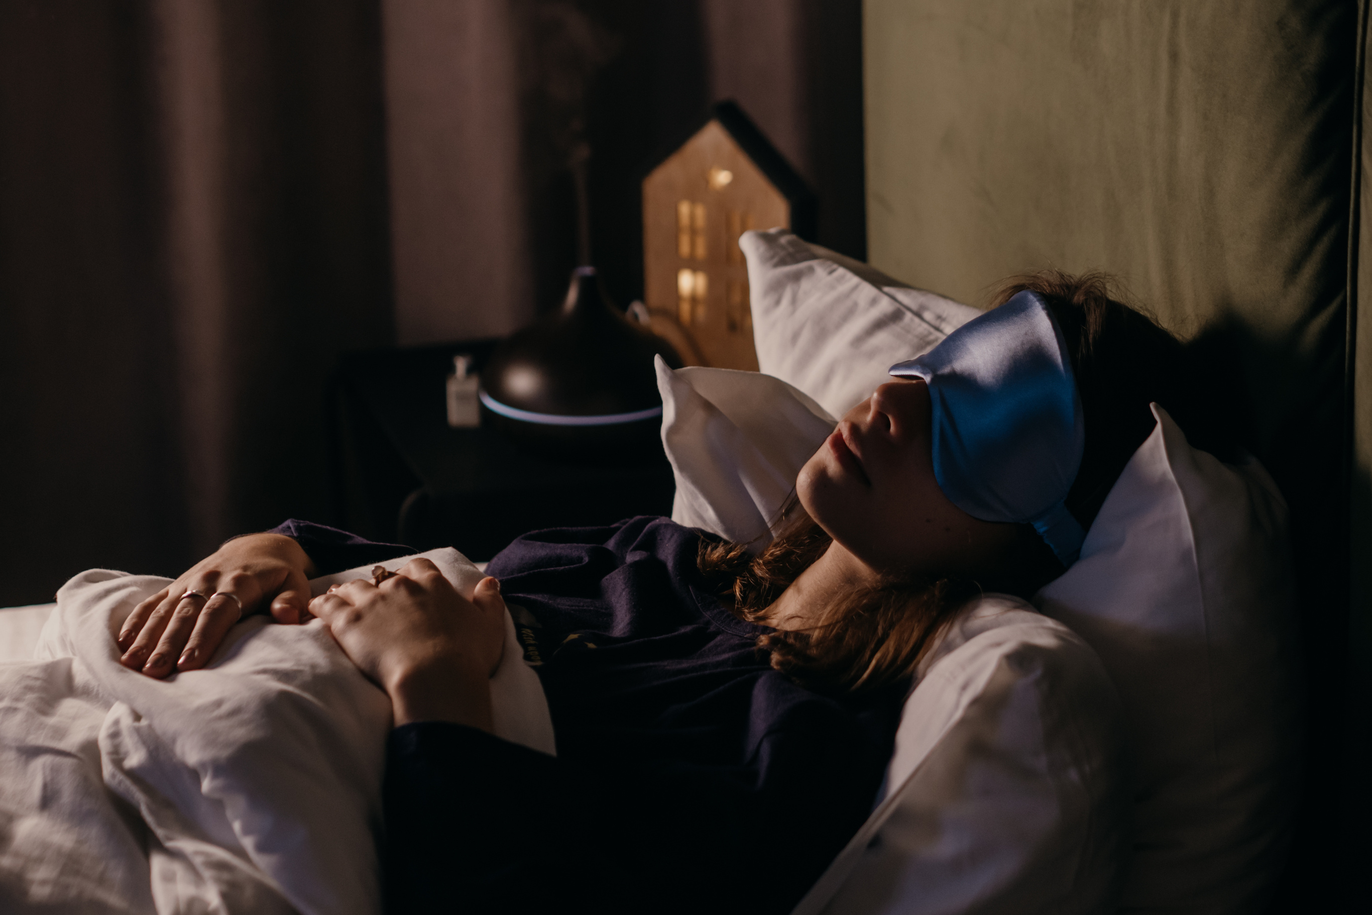
What is sleep hygiene?*
  Your bedroom environment
  Your habits (behaviours) during the day
  Your habits before you go to bed
www.StudySkillsZone.co.uk
*Source: www.nhs.co.uk ‘sleep hygiene – patient information’.
Notes:
Sleep hygiene is just a term used to talk about good habits and environments that promote sleep. It’s not just what you do before bed, but what you do all day that can affect sleep quality.

Slide 19
WHY IS GOOD SLEEP HYGIENE IMPORTANT?*
  improve concentration and memory
  improve mood
  prevent the development sleep disorders (such as insomnia)
  help you to maintain a healthy weight
  lower your risk of developing serious health conditions
  (such as diabetes and heart disease)
  help your to body fight off diseases
To promote good sleep which in turn can:
www.StudySkillsZone.co.uk
Notes:
There are loads of benefits of good sleep hygiene: better memory, mood, health, and even immune strength. It’s not just about feeling rested – sleep supports your whole body and mind.

Slide 20

WHERE CAN YOU LEARN
MORE ABOUT SLEEP HYGIENE?
Search the NHS website for: sleep hygiene
Emotional Changes: Persistent feelings of sadness or hopelessness, and excessive worry or fear.
3-page PDF with everything you need to know plus links to other useful sites
www.StudySkillsZone.co.uk
Notes:
If you’re interested in going deeper, the NHS website has excellent, trustworthy resources. The linked PDF here is a great starting point.

Slide 21

IF SLEEP PROBLEMS PERSIST OR YOU ARE STRUGGLING WITH YOUR MENTAL HEALTH DURING EXAM SEASON (OR AT ANY OTHER TIME), IT’S ESSENTIAL TO SEEK HELP FROM A TRAINED HEALTH PROFESSIONAL.
Mental health is a crucial part of our overall well-being.
Support and understanding from those around us can make a significant difference
www.StudySkillsZone.co.uk
Notes:
“As we wrap up, remember this: if you’re finding things difficult – especially with sleep or your mental health – you’re not alone, and there’s always help available. Don’t hesitate to seek help from a trained professional.”

Slide 22

www.StudySkillsZone.co.uk

Slide 23


