Slide 1


Year 10:
Your Hidden Advantage
What separates calm Year 11 students from stressed ones.
The answer is not talent. It is timing.

Slide 2

STUDY SKILLS ZONE
The Illusion
"I've got loads of time."
Year 11 comes quickly
The year arrives faster than you expect. The workload is real, and the pressure builds from day one.
Pressure changes everything
Under exam pressure, your brain works differently. What felt easy in Year 10 suddenly feels impossible.
Most students realise this too late
By the time the panic sets in, there is not enough time to fix it properly.
Time feels different next year
Weeks disappear. Topics pile up. Every lesson suddenly matters more than it did before.

Slide 3

WHAT USUALLY HAPPENS
This pattern is predictable. You can break it.
Most students follow the same cycle every year. The good news is that knowing the pattern is the first step to changing it.
Autumn: Slow start
Summer: Switch off
Spring: Panic
Exams: Regret
Each stage feeds into the next. A relaxed summer leads to a slow autumn start, which triggers spring panic and exam regret. Break the cycle now, before it begins.
studyskillszone.co.uk | Research-based study skills training

Slide 4

WHAT USUALLY HAPPENS
This pattern is predictable.
You can break it.
Most students follow the same cycle every year. The good news is that knowing the pattern is the first step to changing it.
Top students don't work more
Identify weak areas early
They start earlier. Small, consistent effort now means far less cramming later.
Find your gaps in Year 10 when there is still time to close them properly.
Avoid last-minute panic
Students who prepare early walk into exams calm, confident, and ready.
studyskillszone.co.uk | Research-based study skills training

Slide 5

THE TRUTH
Year 11 is easier if you start now.
Not harder work. Smarter timing.
The students who thrive are not the ones who study the most in Year 11. They are the ones who built their foundation in Year 10.
studyskillszone.co.uk | Research-based study skills training

Slide 6
Start with retrieval
Reading your notes feels productive, but it is not enough. The skill that actually carries you through Year 11 is being able to recall information without looking at your books.
1
2
3
Test yourself
Use flashcards
Write from memory
Cover your notes and try to recall key facts. This builds real memory, not just recognition.
Short, focused questions force your brain to retrieve information actively and efficiently.
Put pen to paper without looking. This is the skill that changes everything in Year 11.
studyskillszone.co.uk | Research-based study skills training

Slide 7
THE ONE HABIT THAT CHANGES EVERYTHING
There is no neutral.
Every study session moves you forward, or every skipped session leaves you further behind.
Makes next year easier
Makes it harder
Small habits built now compound into massive advantages. Future you will be grateful for every session started today.
Every week without preparation is a week of pressure added to next year. There is no pause button on time.
studyskillszone.co.uk | Research-based study skills training

Slide 8
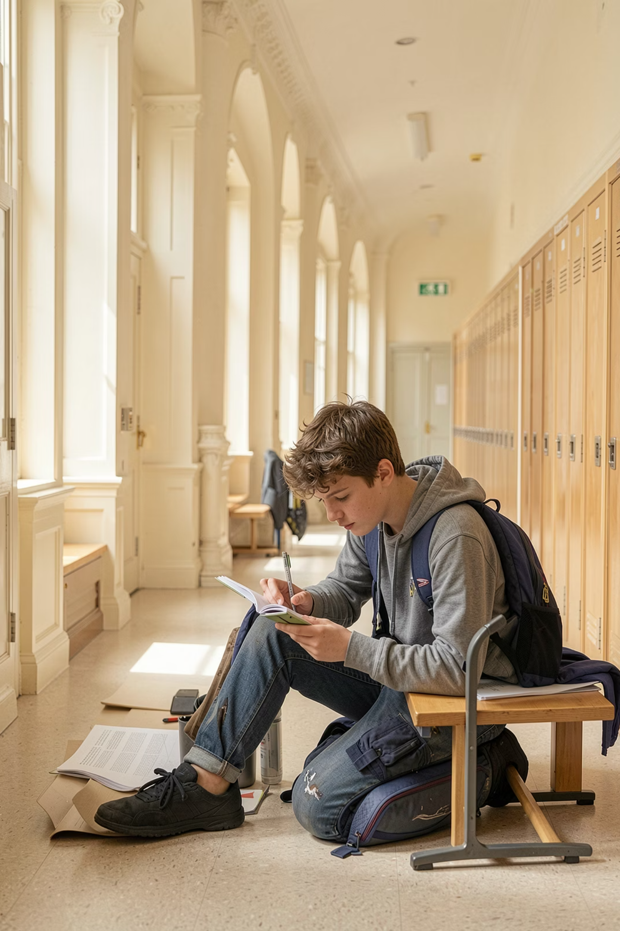
YOUR ADVANTAGE STARTS NOW
Start small.
Start now.
Give yourself an advantage most students simply do not have.
You do not need a perfect plan. You just need to begin.
"This is the skill that changes everything."
studyskillszone.co.uk | Research-based study skills training

